Slide 1


Amazon Clone Using HTML, CSS, and JavaScript
This presentation outlines the process of creating a functional Amazon clone using fundamental web technologies. The project will encompass front-end development, including HTML structure, CSS styling, and JavaScript functionality.

Slide 2
Introduction to E-commerce Platforms
1
Online Marketplace
2
User Interface
E-commerce platforms facilitate buying and selling of goods and services online.
They provide a user-friendly interface for customers to browse, select, and purchase items.
3
Transaction Management
E-commerce platforms handle payment processing, order fulfillment, and customer support.

Slide 3
Key Features of Amazon
Product Listings
Customer Reviews
Shopping Cart
Extensive product catalog with detailed descriptions and images.
User-generated reviews and ratings to inform purchase decisions.
Virtual cart to store selected items and manage quantities.
Search and filtering options to easily find desired items.
Secure checkout process with various payment options.

Slide 4
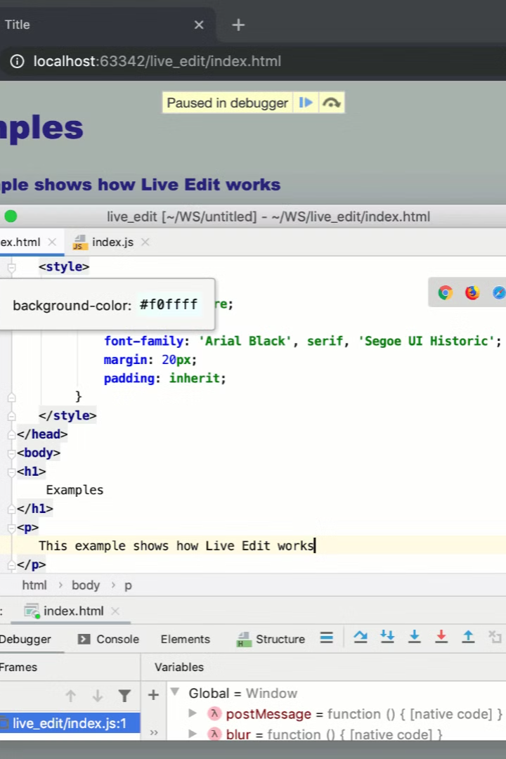
Setting up the Development Environment
1
Install Text Editor
Choose a code editor like VS Code or Sublime Text for writing code.
2
Set Up Project Folder
Create a new project folder to store HTML, CSS, and JavaScript files.
3
Open in Editor
Open the project folder in the chosen code editor.
4
Create Basic Files
Create index.html, style.css, and script.js files for initial development.

Slide 5
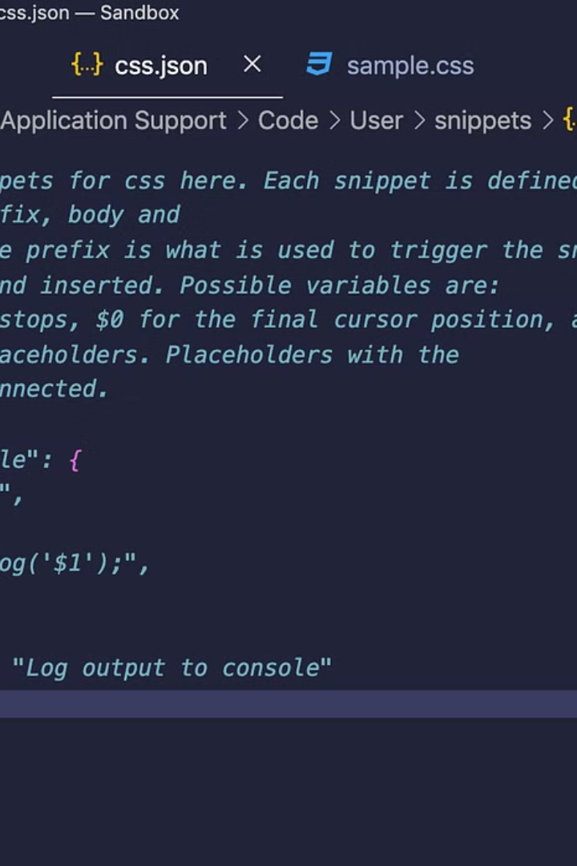
Creating the HTML Structure
Header Section
Main Content Area
Include the logo, navigation menu, search bar, and user account options.
Display product listings, category browsing, and promotional banners.
Footer Section
Contain copyright information, links to policies, and contact details.

Slide 6
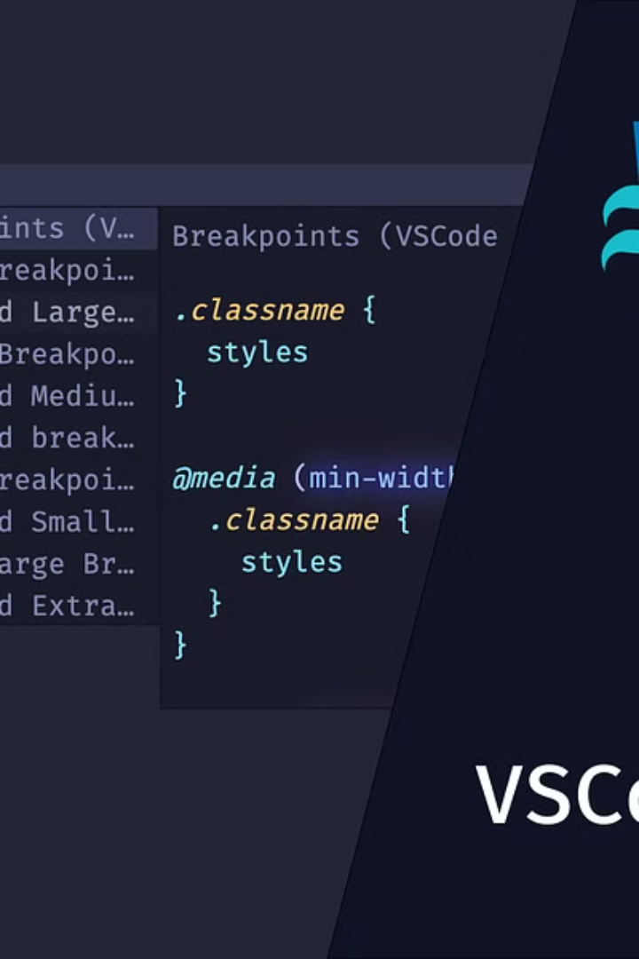



Styling with CSS
Typography
Define font styles, sizes, and colors for text elements.
Layout
Use CSS grid or flexbox to arrange elements on the page.
Visuals
Apply background images, colors, and borders to create a visually appealing design.

Slide 7
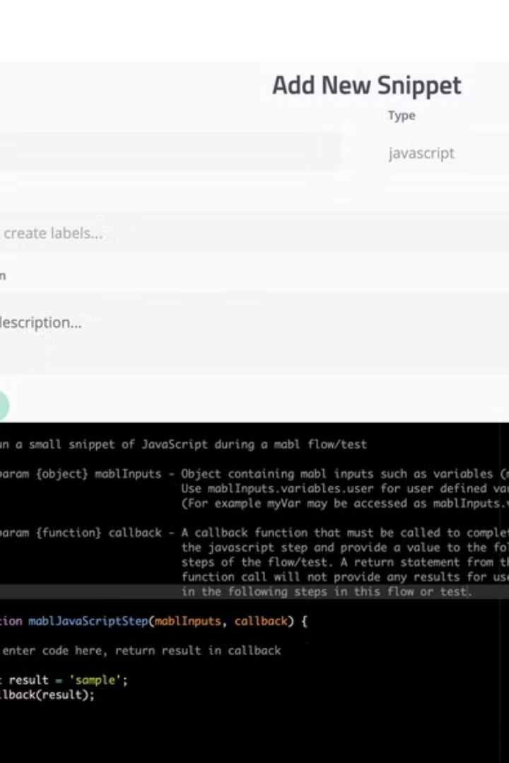
Implementing JavaScript Functionality
Functionality
Description
Search Functionality
Implement search bar functionality to filter products.
Dynamic Product Display
Load product data dynamically from a data source.
Shopping Cart Management
Add and remove items from the shopping cart.

Slide 8
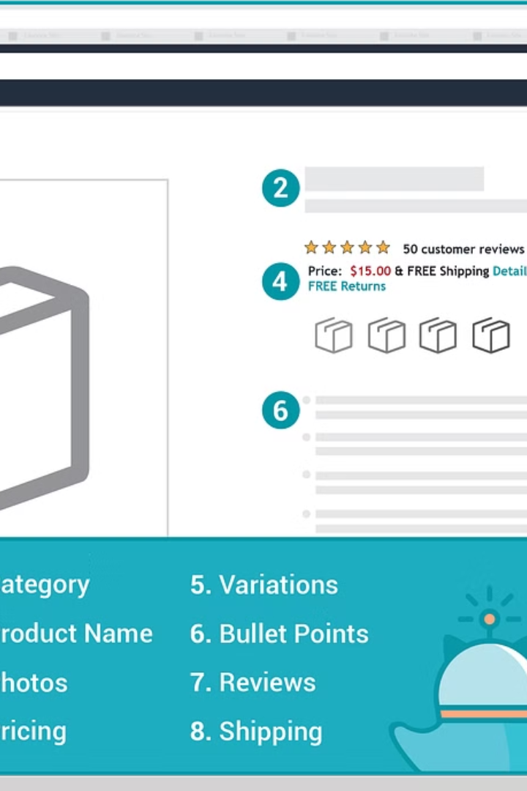




Product Listings and Categories
Grid Layout
Category Filtering
Use CSS grid to arrange products in a visually appealing grid.
Implement filters to narrow down products by category.
Sorting Options
Product Details
Allow users to sort products by price, popularity, or relevance.
Display product name, description, price, and reviews.

Slide 9
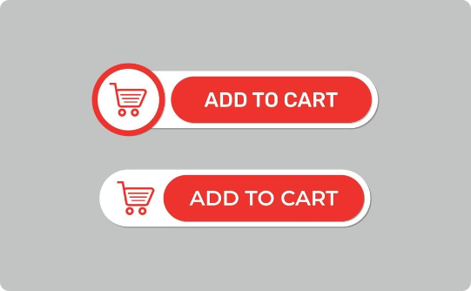

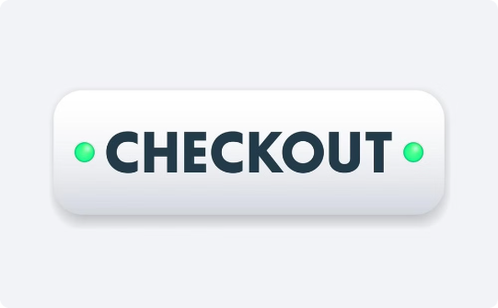
Shopping Cart and Checkout Process
Add to Cart
Cart Summary
Checkout Process
Implement a button to add selected items to the shopping cart.
Display a summary of items in the cart, including quantities and prices.
Guide users through the checkout process, including shipping details and payment.

Slide 10
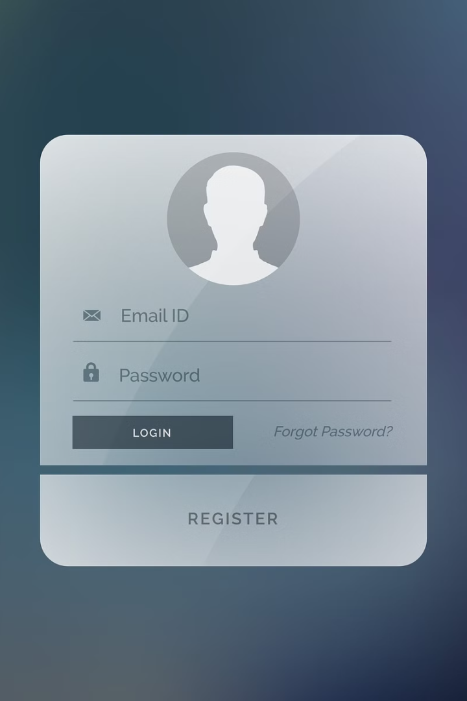
User Authentication and Account Management
Login/Registration
Account Management
Allow users to create accounts or log in to existing accounts.
Enable users to manage their personal information, order history, and saved addresses.
Security Measures
Implement robust security measures to protect user data and prevent unauthorized access.

